Slide 1

Intelligent Core of Battery Energy Storage Systems
By Sebastian Russo and Javier Peres

Slide 2
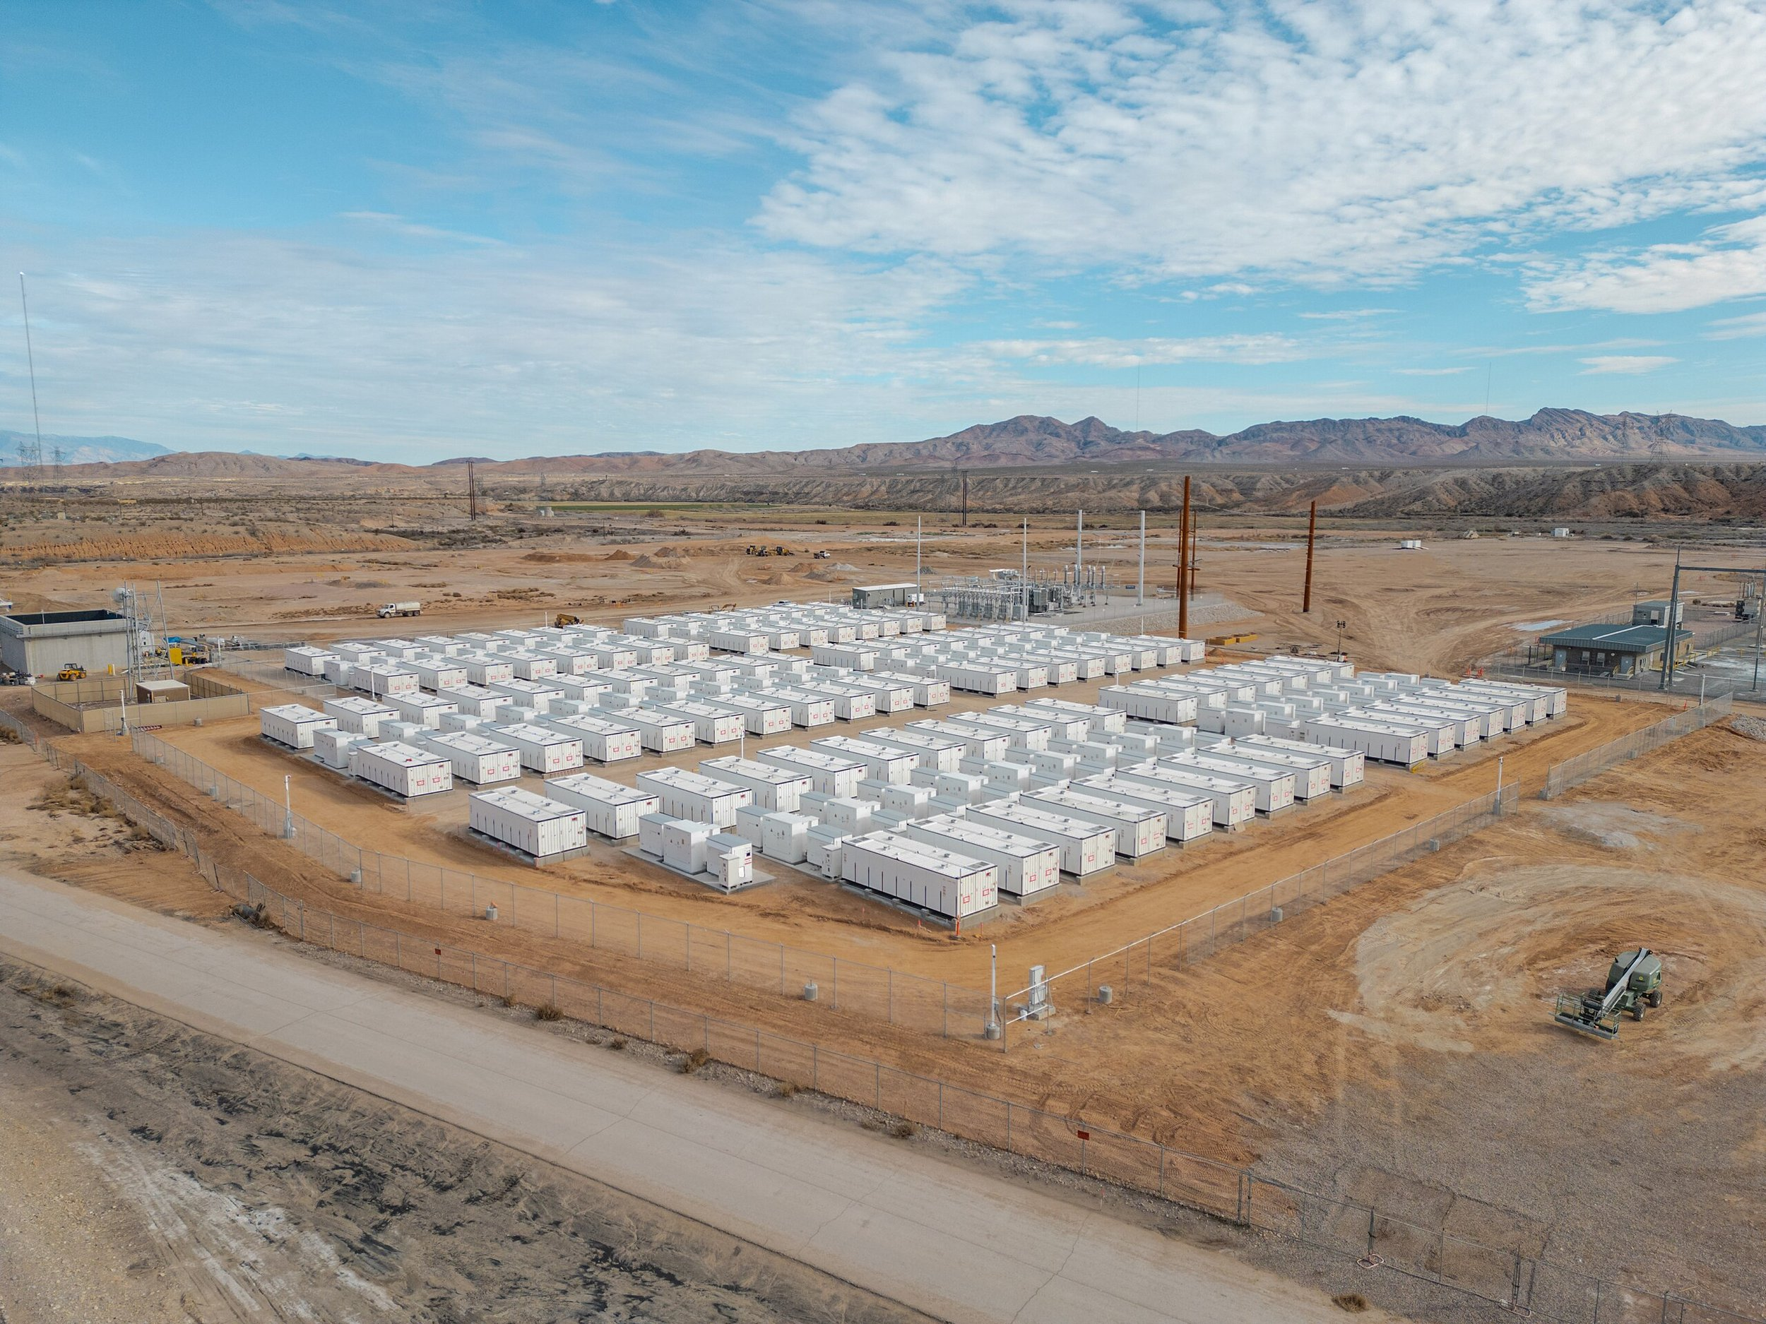
Challenge
Build Battery Energy Storage System (BESS) platform prototype.
Requirements:
Accept and process real-time and historical BESS data
Display actionable insights for technical asset managers
Be extensible for third parties (optimizers, grid operators)
Include at least one innovative feature beyond generic dashboards
EU compliant sensors and controllers

Slide 3
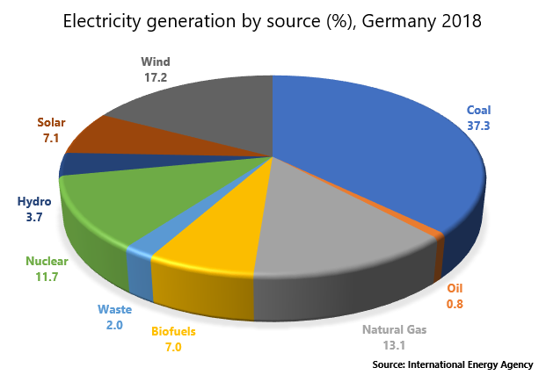
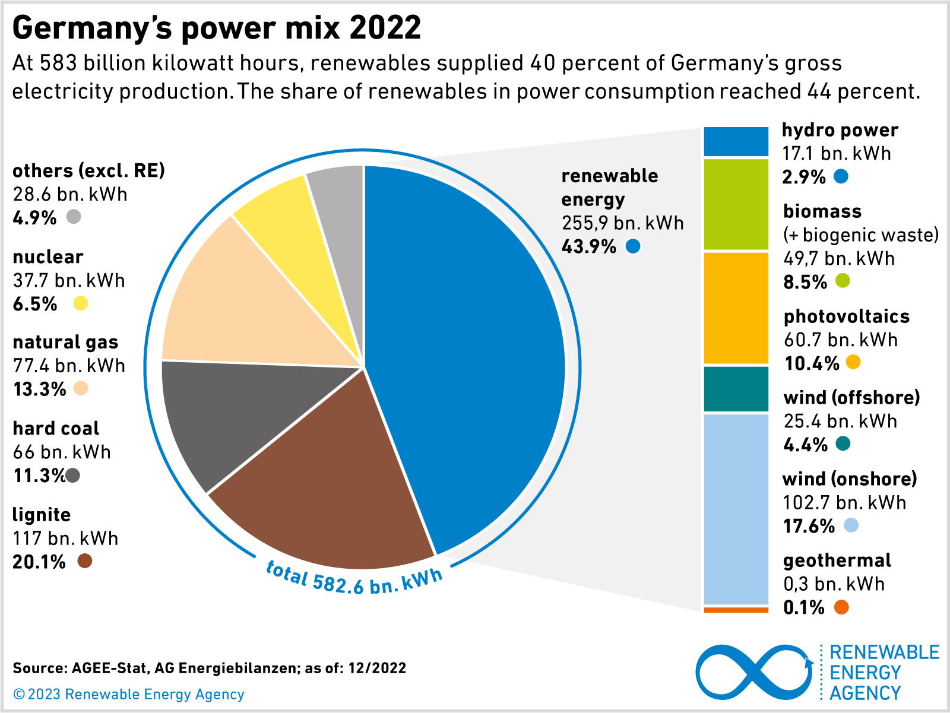
Energy production in Germany
Germany intends to increase these numbers from 20GWh to 100GWh by 2030

Slide 4

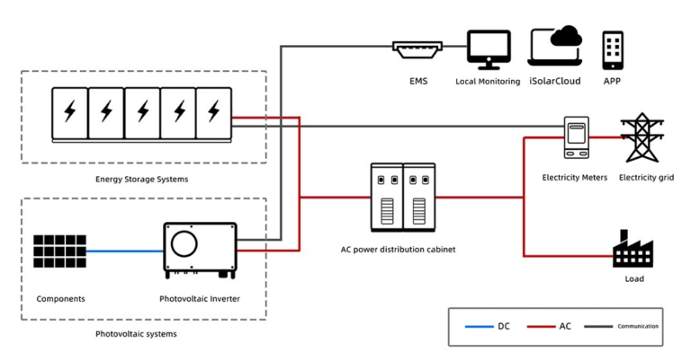
It must be closely monitored
Fires related to batteries withing BESS grid architecture have occurred several times over the years
Fortunately, no casualties have been recorded but damages ranged between 500.000 to 700.000 euros.
Examples constitute Liverpool 2020, Essex 2025 or Neermor 2024
It has been reported the batteries are vulnerable to fire and high temperatures

Slide 5
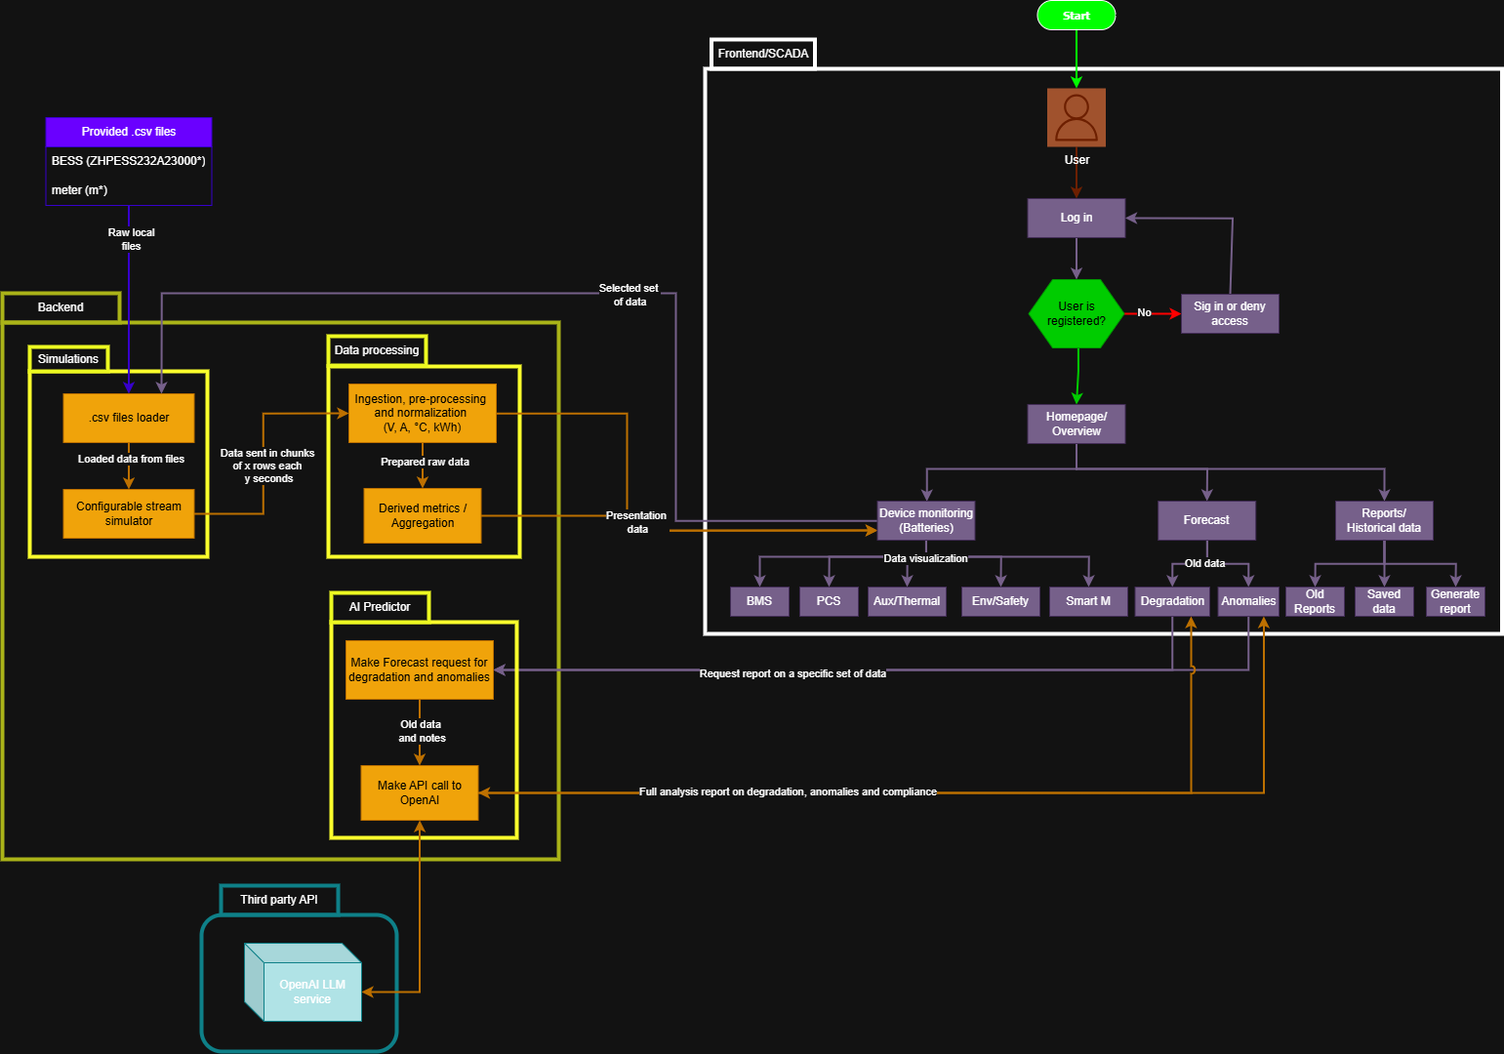
Demo architectural workflow

Slide 6
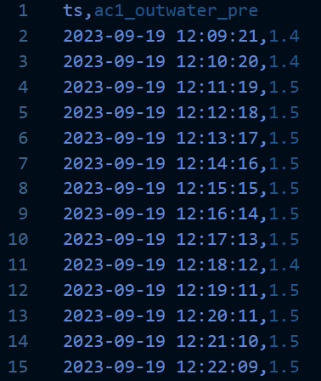
EDA (Exploratory data analysis)
Details:
41 .csv files for each ZHPESS232A23000* directory (Batteries)
5 .csv files for each m* directory (smart meters)
Each csv file contains only a timestamp and a single metric, corresponding 1 for each sensor
6GB in total for data between 2023 and 2025
Many sensors provide data at different frequencies
Standards and conventions not specified
Units specified and relevant values specified in README for BMS, PCS, Aux-Thermal, Env-Safety and Smart meters
Challenging to analyze

Slide 7
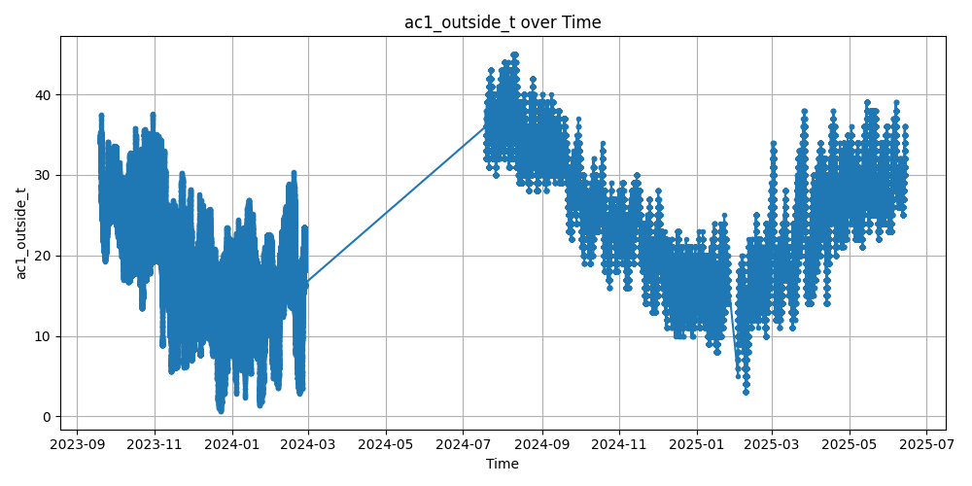
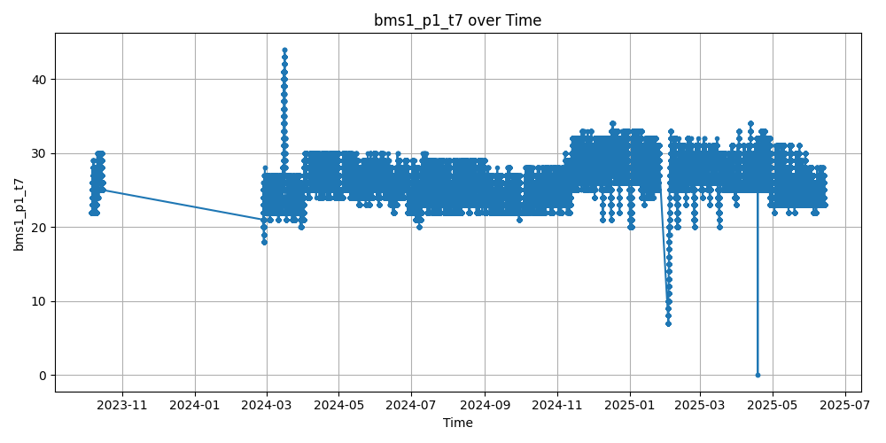
EDA (Examples)

Slide 8
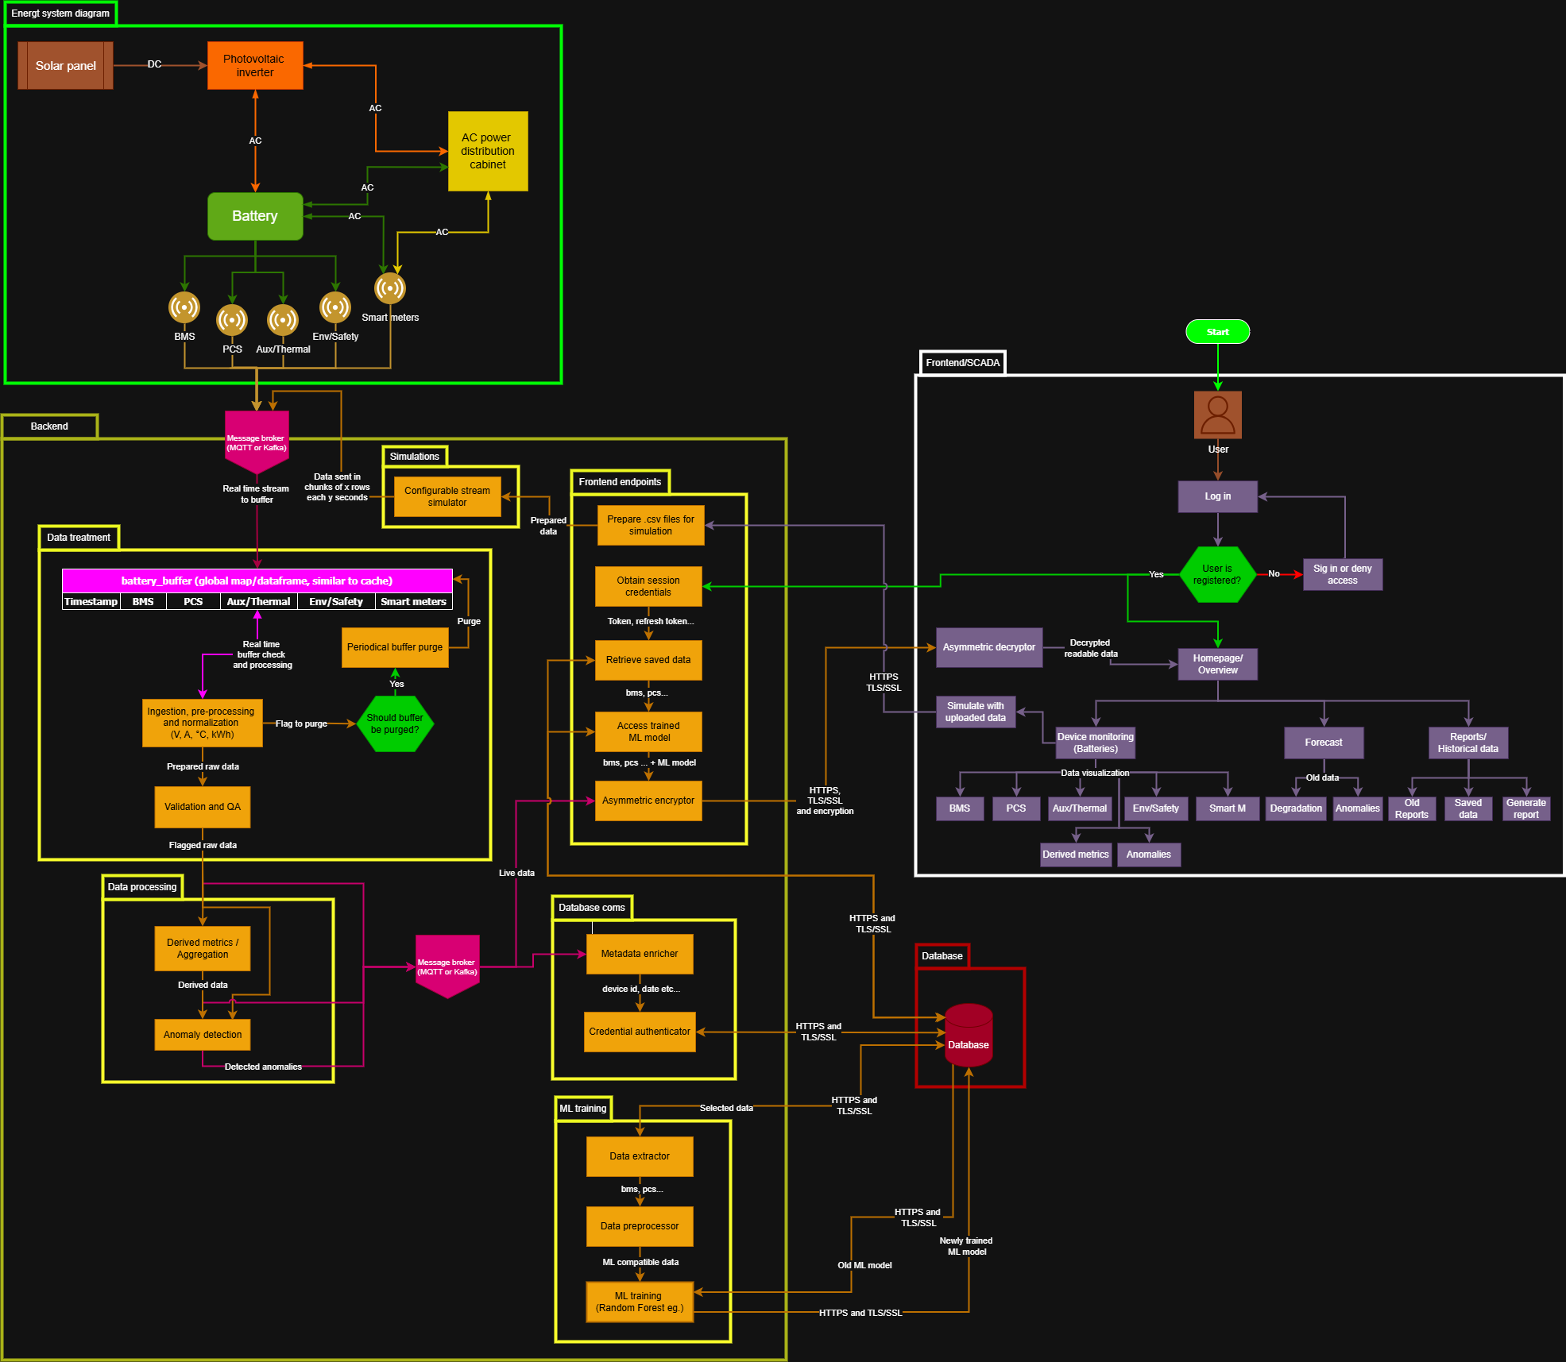
Theoretical architectural workflow
Kinda big right?

Slide 9
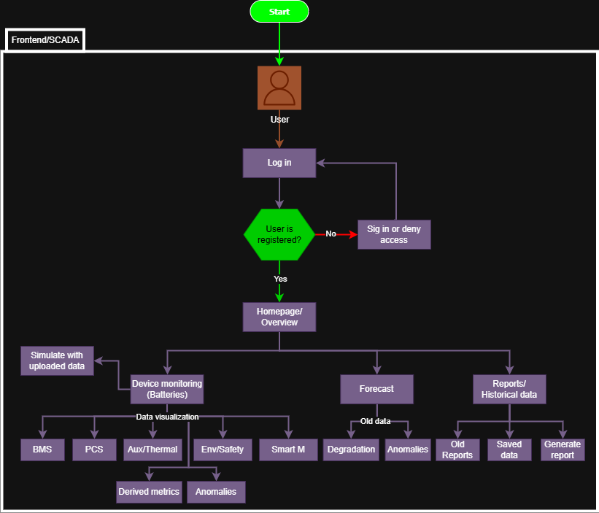
Possible monetization
Basic monitoring capabilities offered as a basic plan
Offer forecast feature as a plug in that implements the trained ML model
Offer feature for sharing reports and using AI to generated improved reports
Offer use cases data to other companies if possible

Slide 10


Thanks for your attention!!!

